Slide 1
Principles of Distributed Database Systems
M. Tamer Özsu
Patrick Valduriez

Slide 2
Outline
Distributed and Parallel Database Design
Fragmentation
Data distribution
Combined approaches

Slide 3
Distribution Design
Top-down
mostly in designing systems from scratch
mostly in homogeneous systems
Issues: fragmentation & allocation
Bottom-up
when the databases already exist at a number of sites
Integrating existing databases into one database
Issues: Design of the export and global schemas
Integrating local schemas into global conceptual schema

Slide 4
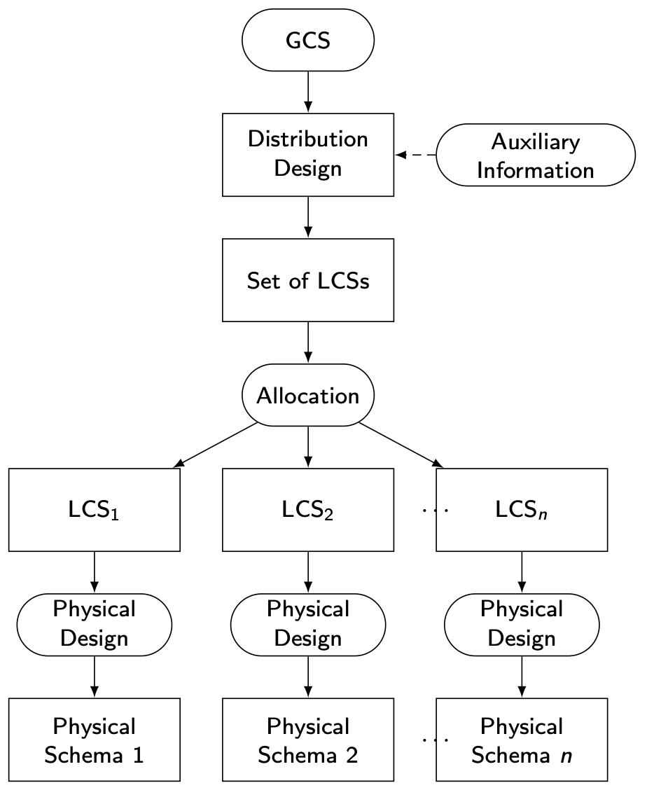
Distribution Design
GCS: Global Conceptual Schema
LCS: Local Conceptual Schema

Slide 5
Relational Algebra
Specify how to obtain the result using a set of operators
Form
⟨Operator⟩_{⟨parameters⟩} ⟨Operands⟩ → ⟨Result⟩
↓ ↓
Relation (s) Relation

Slide 6
Relational Algebra Operators
Fundamental
Selection
Projection
Union
Set difference
Intersection
Union compatibility
Same degree (number of attributes)
Corresponding attributes defined over the same domain
Additional
Cartesian product
θ-join
Equi join
Natural join
Semi join
Outer join
Division

Slide 7
Selection
Produces a horizontal subset of the operand relation
General form
σ_{F}(R)={t |t∈R and F(t) is true}
where
R is a relation, t is a tuple variable
F is a formula consisting of
operands that are constants or attributes
arithmetic comparison operators
<, >, =, ≠, ≤, ≥
logical operators
∧, ∨, ¬

Slide 8
Selection Example
EMP
ENO
ENAME
TITLE
E1
J. Doe
Elect. Eng.
E2
M. Smith
Syst. Anal.
σ_{TITLE='Elect. Eng.'}(EMP)
E3
A. Lee
Mech. Eng.
ENO
ENAME
TITLE
E4
J. Miller
Programmer
E5
B. Casey
Syst. Anal.
E1
J. Doe
Elect. Eng
E6
L. Chu
Elect. Eng.
E6
L. Chu
Elect. Eng.
E7
R. Davis
Mech. Eng.
E8
J. Jones
Syst. Anal.

Slide 9
Projection
Produces a vertical slice of a relation
General form
Π_{A1,…,An}(R)={t[A₁,…, A_{n}] | t∈R}
where
R is a relation, t is a tuple variable
{A₁,…, A_{n}} is a subset of the attributes of R over which the projection will be performed
Note: projection can generate duplicate tuples. Commercial systems (and SQL) allow this and provide
Projection with duplicate elimination
Projection without duplicate elimination

Slide 10
Projection Example
PROJ
Π_{PNO,BUDGET}(PROJ)
PNO
PNAME
BUDGET
PNO
BUDGET
P1
Instrumentation
150000
P1
150000
P2
Database Develop.
135000
P2
135000
P3
CAD/CAM
250000
P3
250000
P4
Maintenance
310000
P4
310000

Slide 11
Union
Similar to set union
General form
R ∪ S={t | t ∈ R or t ∈ S}
where R, S are relations, t is a tuple variable
Result contains tuples that are in R or in S, but not both (duplicates removed)
R, S should be union-compatible

Slide 12
Set Difference
General Form
R – S = {t |t ∈ R and t ∉ S}
where R and S are relations, t is a tuple variable
Result contains all tuples that are in R, but not in S.
R – S ≠ S – R
R, S union-compatible

Slide 13
Intersection
Typical set intersection
R ∩S = {t | t ∈ R and t ∈ S}
= R – (R – S)
R, S union-compatible

Slide 14
Cartesian (Cross) Product
Given relations
R of degree k_{1 ,} cardinality n₁
S of degree k_{2 ,} cardinality n₂
Cartesian (cross) product:
R × S = {t [A₁,…,A_{k1}, A_{k1+1},…,A_{k1+k2}] | t[A₁,…,A_{k1}] ∈ R and t[A_{k1+1},…,A_{k1+k2}] ∈ S}
The result of R ⋅ S is a relation of degree (k₁+ k₂) and consists of all (n₁* n₂)-tuples where each tuple is a concatenation of one tuple of R with one tuple of S.

Slide 15
Cartesian Product Example
EMP
EMP × PAY
ENO
ENAME
TITLE
ENO
ENAME
EMP.TITLE
PAY.TITLE
SALARY
E1
J. Doe
Elect. Eng
E1
J. Doe
Elect. Eng.
Elect. Eng.
55000
E2
M. Smith
Syst. Anal.
E1
J. Doe
Elect. Eng.
Syst. Anal.
70000
E3
A. Lee
Mech. Eng.
E1
J. Doe
Elect. Eng.
Mech. Eng.
45000
E4
J. Miller
Programmer
E1
J. Doe
Elect. Eng.
Programmer
60000
E5
B. Casey
Syst. Anal.
E2
M. Smith
Syst. Anal.
Elect. Eng.
55000
E6
L. Chu
Elect. Eng.
E2
M. Smith
Syst. Anal.
Syst. Anal.
70000
E7
R. Davis
Mech. Eng.
E2
M. Smith
Syst. Anal.
Mech. Eng.
45000
E8
J. Jones
Syst. Anal.
E2
M. Smith
Syst. Anal.
Programmer
60000
E3
A. Lee
Mech. Eng.
Elect. Eng.
55000
PAY
E3
A. Lee
Mech. Eng.
Syst. Anal.
70000
E3
A. Lee
Mech. Eng.
Mech. Eng.
45000
TITLE
SALARY
E3
A. Lee
Mech. Eng.
Programmer
60000
Elect. Eng.
55000
E8
J. Jones
Syst. Anal.
Elect. Eng.
55000
Syst. Anal.
70000
E8
J. Jones
Syst. Anal.
Syst. Anal.
70000
Mech. Eng.
45000
E8
J. Jones
Syst. Anal.
Mech. Eng.
45000
Programmer
60000
E8
J. Jones
Syst. Anal.
Programmer
60000

Slide 16
Join Operations
Theta join
Equi join
Natural join
Semi join
Outer join

Slide 17
θ−Join
General form
R ⋈_{F(R.Ai,S.Bj)} S={t[A₁,…,A_{n},B₁,…,B_{m}] |
t[A₁,…,A_{n}] ∈ R and t[B₁,…,B_{m}] ∈ S
and F(R.A_{i}, S.B_{j}) is true}
where
R, S are relations, t is a tuple variable
F (R.A_{i}, S.B_{j}) is a formula defined as that of selection.
A derivative of Cartesian product
R ⋈_{F} S = σ_{F}(R × S)

Slide 18
Types of Join
Equi-join
The formula F only contains equality
R ⋈_{R.A=S.B} S
Natural join
Equi-join of two relations R and S over an attribute (or attributes) common to both R and S and projecting out one copy of those attributes
R ⋈ S = Π_{R∪S}σ_{F}(R × S)

Slide 19
Natural Join Example
EMP
ENO
ENAME
TITLE
EMP ⋈ PAY
E1
J. Doe
Elect. Eng
E2
M. Smith
Syst. Anal.
ENO
ENAME
TITLE
SALARY
E3
A. Lee
Mech. Eng.
E4
J. Miller
Programmer
E1
J. Doe
Elect. Eng.
55000
E5
B. Casey
Syst. Anal.
E2
M. Smith
Analyst
70000
E6
L. Chu
Elect. Eng.
E3
A. Lee
Mech. Eng.
45000
E7
R. Davis
Mech. Eng.
E8
J. Jones
Syst. Anal.
E4
J. Miller
Programmer
60000
PAY
E5
B. Casey
Syst. Anal.
70000
E6
L. Chu
Elect. Eng.
55000
TITLE
SALARY
E7
R. Davis
Mech. Eng.
45000
Elect. Eng.
55000
E8
J. Jones
Syst. Anal.
70000
Syst. Anal.
70000
Mech. Eng.
45000
Join is over the common attribute TITLE
Programmer
60000

Slide 20
Types of Join
Outer-Join
Ensures that tuples from one or both relations that do not satisfy the join condition still appear in the final result with other relation’s attribute values set to NULL
Left outer join
Right outer join
Full outer join

Slide 21
Outer Join – Example
Relation instructor
ID
name
dept_name
10101
12121
15151
Srinivasan
Wu
Mozart
Comp. Sci.
Finance
Music
Relation teaches
ID
course_id
10101
12121
76766
CS-101
FIN-201
BIO-101

Slide 22
Outer Join – Example
Join instructor teaches
ID
name
dept_name
course_id
10101
12121
Srinivasan
Wu
Comp. Sci.
Finance
CS-101
FIN-201
Left Outer Join
instructor teaches
ID
name
dept_name
course_id
10101
12121
15151
Srinivasan
Wu
Mozart
Comp. Sci.
Finance
Music
CS-101
FIN-201
null

Slide 23
Outer Join – Example
Right Outer Join
instructor teaches
ID
name
dept_name
course_id
10101
12121
76766
Srinivasan
Wu
null
Comp. Sci.
Finance
null
CS-101
FIN-201
BIO-101
Full Outer Join
instructor teaches
ID
name
dept_name
course_id
10101
12121
15151
76766
Srinivasan
Wu
Mozart
null
Comp. Sci.
Finance
Music
null
CS-101
FIN-201
null
BIO-101

Slide 24
Semijoin
Derivation
R ⋉_{F} S = Π_{A}(R ⋈_{F} S) = Π_{A}(R) ⋈ Π_{A∩B}(S) = R ⋈_{F} Π_{A∩B}(S)
where
R, S are relations
A is a set of attributes

Slide 25
Semijoin – Example
semijoin instructor ⋉ teaches
ID
name
dept_name
10101
12121
Srinivasan
Wu
Comp. Sci.
Finance
semijoin
teaches ⋉ instructor
ID
course_id
10101
12121
CS-101
FIN-201

Slide 26
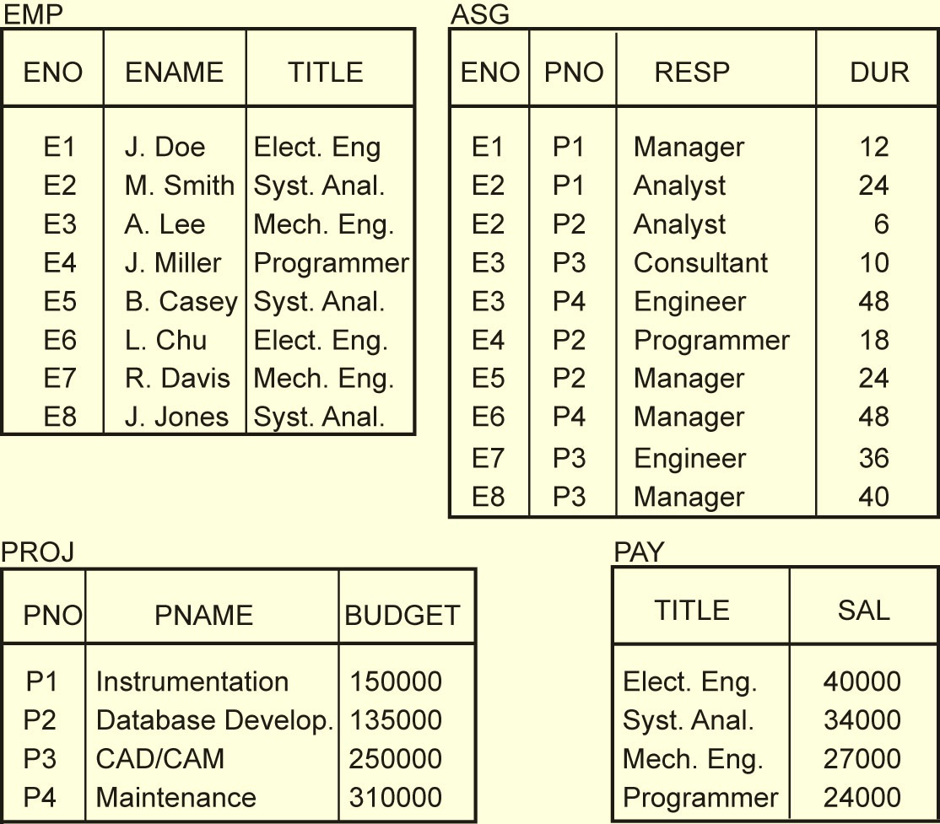
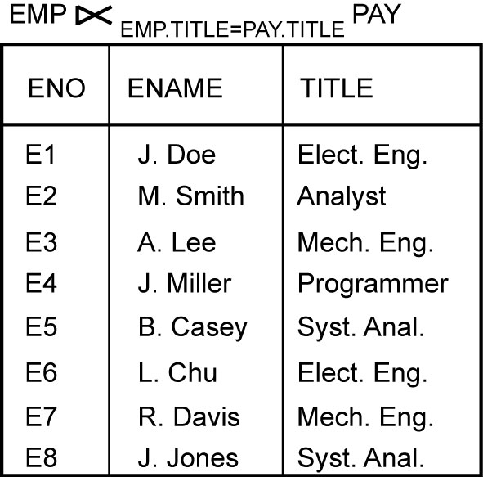
Semijoin Example

Slide 27
Outline
Distributed and Parallel Database Design
Fragmentation
Data distribution
Combined approaches

Slide 28
Fragmentation
Can't we just distribute relations?
What is a reasonable unit of distribution?
relation
views are subsets of relations ➔ locality
extra communication
fragments of relations (sub-relations)
concurrent execution of a number of transactions that access different portions of a relation
views that cannot be defined on a single fragment will require extra processing
semantic data control (especially integrity enforcement) more difficult

Slide 29
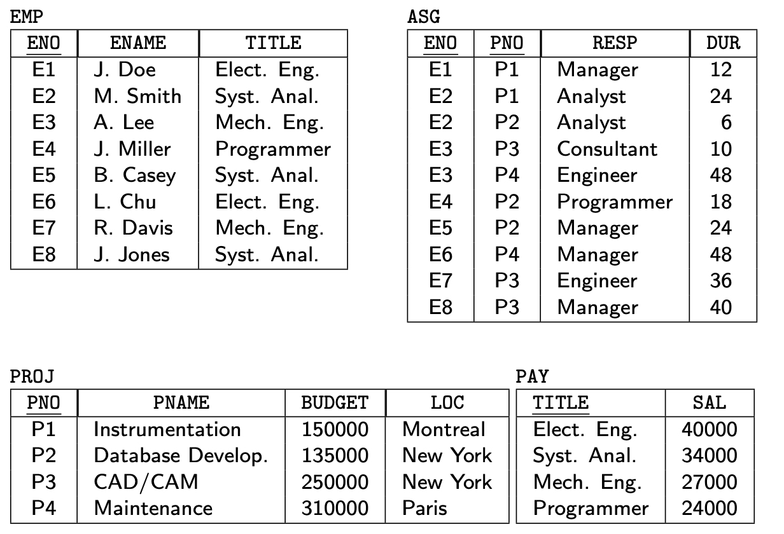
Example Database

Slide 30
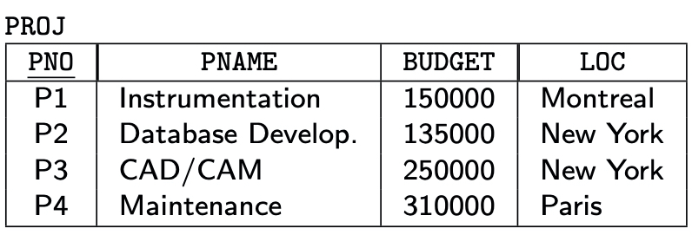
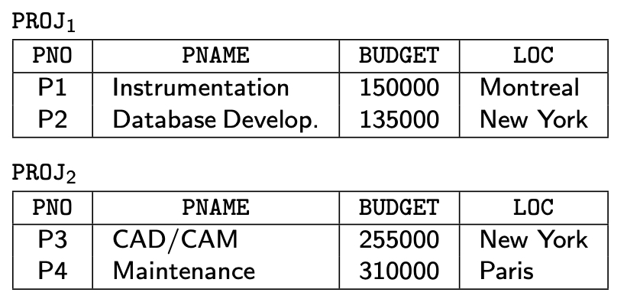
Fragmentation Alternatives – Horizontal
PROJ₁ : projects with budgets less than $200,000
PROJ₂ : projects with budgets greater than or equal to $200,000

Slide 31
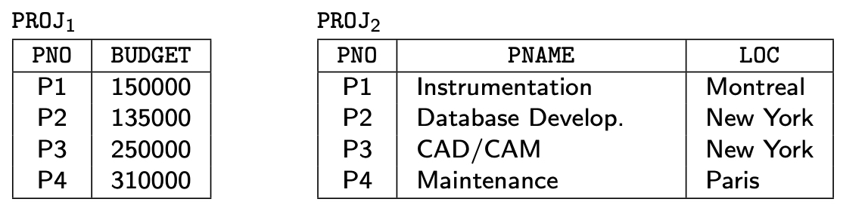
Fragmentation Alternatives – Vertical
PROJ₁: information about project budgets
PROJ₂: information about project names and locations

Slide 32
Correctness of Fragmentation
Completeness
Decomposition of relation R into fragments R₁, R₂, ..., R_{n} is complete if and only if each data item in R can also be found in some R_{i}
Reconstruction
If relation R is decomposed into fragments R₁, R₂, ..., R_{n}, then there should exist some relational operator ∇ such that
R = ∇_{1≤i≤n}R_{i}
Disjointness
If relation R is decomposed into fragments R₁, R₂, ..., R_{n}, and data item d_{i} is in R_{j}, then d_{i} should not be in any other fragment R_{k} (k ≠ j ).

Slide 33
Allocation Alternatives
Non-replicated
partitioned : each fragment resides at only one site
Replicated
fully replicated : each fragment at each site
partially replicated : each fragment at some of the sites
Rule of thumb:

Slide 34
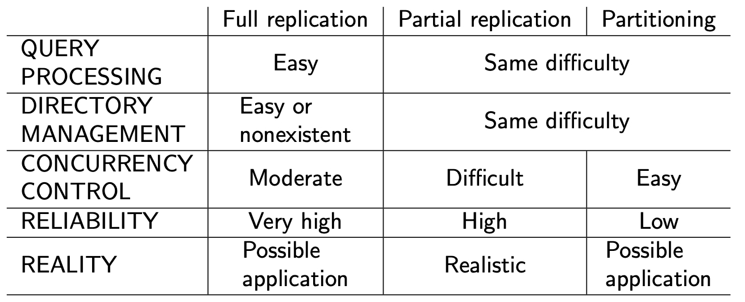
Comparison of Replication Alternatives

Slide 35
Fragmentation
Horizontal Fragmentation (HF)
Primary Horizontal Fragmentation (PHF)
Derived Horizontal Fragmentation (DHF)
Vertical Fragmentation (VF)
Hybrid Fragmentation (HF)
Information Requirements
Database Information
Application Information

Slide 36
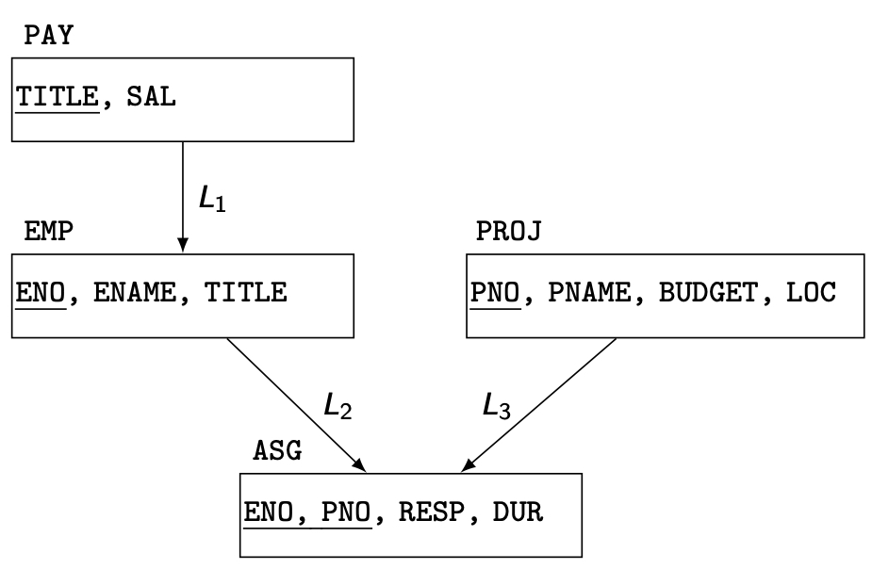
HF – Information Requirements
Database Information
Relationship (The relation at the tail of an edge is called the source (owner) of the edge and the relation at the head is called the target (member).)
the direction of the edge shows a one-to-many relationship.
Cardinality of each relation: card(R)

Slide 37
HF - Information Requirements
Application Information
simple predicates : Given R[A₁, A₂, …, A_{n}], a simple predicate p_{j} is
p_{j} : A_{i} θ Value
where θ ∈ {=,<,≤,>,≥,≠}, Value ∈ D_{i} and D_{i} is the domain of A_{i}.
For relation R we define Pr = {p₁, p₂, …,p_{m}}
Example :
PNAME = "Maintenance"
BUDGET ≤ 200000
minterm predicates : Given R and Pr = {p₁, p₂, …,p_{m}}
define M = {m₁,m₂,…,m_{r}} as
M = { m_{i} | m_{i} = ∧_{pj∈Pr} p_{j}* }, 1≤j≤m, 1≤i≤z
where p_{j}* = p_{j} or p_{j}* = ¬(p_{j}).

Slide 38
HF – Information Requirements
Example
m₁: PNAME="Maintenance" ∧ BUDGET≤200000
m₂: NOT(PNAME="Maintenance") ∧ BUDGET≤200000
m₃: PNAME= "Maintenance" ∧ NOT(BUDGET≤200000)
m₄: NOT(PNAME="Maintenance") ∧ NOT(BUDGET≤200000)

Slide 39
HF – Information Requirements
Application Information
minterm selectivities: sel(m_{i})
The number of tuples of the relation that would be accessed by a user query which is specified according to a given minterm predicate m_{i}.
access frequencies: acc(q_{i})
The frequency with which a user application qi accesses data.
Access frequency for a minterm predicate can also be defined.

Slide 40
Primary Horizontal Fragmentation (PHF)
Definition :
R_{j} = σ_{Fj}(R), 1 ≤ j ≤ w
where F_{j} is a selection formula, which is (preferably) a minterm predicate.
Therefore,
A horizontal fragment R_{i} of relation R consists of all the tuples of R which satisfy a minterm predicate m_{i}.
⬇
Given a set of minterm predicates M, there are as many horizontal fragments of relation R as there are minterm predicates.
Set of horizontal fragments also referred to as minterm fragments.

Slide 41
PHF
For example, for each title there are multiple employees with that title; thus, there is an edge between the PAY and EMP relations.
Along the same lines, the many-to-many relationship between the EMP and PROJ relations is expressed with two edges to the ASG relation.
Primary horizontal fragmentation applies to the relations that have no incoming edges in the join graph and performed using the predicates that are defined on that relation.
In our examples, relations PAY and PROJ are subject to primary horizontal fragmentation, and EMP and ASG are subject to derived horizontal fragmentation.

Slide 42
PHF – Algorithm
Given: A relation R, the set of simple predicates Pr
Output: The set of fragments of R = {R₁, R₂,…,R_{w}} which obey the fragmentation rules.
Preliminaries :
Pr should be complete
Pr should be minimal

Slide 43
Completeness of Simple Predicates
A set of simple predicates Pr is said to be complete if and only if the accesses to the tuples of the minterm fragments defined on Pr requires that two tuples of the same minterm fragment have the same probability of being accessed by any application.
Example :
Assume PROJ[PNO,PNAME,BUDGET,LOC] has two applications defined on it.
Find the budgets of projects at each location. (1)
Find projects with budgets less than $200000. (2)

Slide 44
Completeness of Simple Predicates
According to (1),
Pr={LOC=“Montreal”, LOC=“New York”, LOC=“Paris”}
which is not complete with respect to (2).
Modify
Pr ={LOC=“Montreal”, LOC=“New York”, LOC=“Paris”, BUDGET≤200000, BUDGET>200000}
which is complete.

Slide 45
Minimality of Simple Predicates
If a predicate influences how fragmentation is performed, (i.e., causes a fragment f to be further fragmented into, say, f_{i} and f_{j}) then there should be at least one application that accesses f_{i} and f_{j} differently.
In other words, the simple predicate should be relevant in determining a fragmentation.
If all the predicates of a set Pr are relevant, then Pr is minimal.

Slide 46
Minimality of Simple Predicates
Example :
Pr ={LOC=“Montreal”,LOC=“New York”, LOC=“Paris”,
BUDGET≤200000,BUDGET>200000}
is minimal (in addition to being complete). However, if we add
PNAME = “Instrumentation”
then Pr is not minimal.

Slide 47
COM_MIN Algorithm
Given: a relation R and a set of simple predicates Pr
Output: a complete and minimal set of simple predicates Pr' for Pr
Rule 1: a relation or fragment is partitioned into at least two parts which are accessed differently by at least one application.

Slide 48
COM_MIN Algorithm
Initialization :
find a p_{i} ∈ Pr such that p_{i} partitions R according to Rule 1
set Pr' = p_{i} ; Pr ←Pr – {p_{i}} ; F ← {f_{i}}
Iteratively add predicates to Pr' until it is complete
find a p_{j} ∈ Pr such that p_{j} partitions some f_{k} defined according to minterm predicate over Pr' according to Rule 1
set Pr' = Pr' ∪ {p_{i}}; Pr ←Pr – {p_{i}}; F ← F ∪ {f_{i}}
if ∃p_{k} ∈ Pr' which is nonrelevant then
Pr' ← Pr – {p_{i}}
F ← F – {f_{i}}

Slide 49
PHORIZONTAL Algorithm
Makes use of COM_MIN to perform fragmentation.
Input: a relation R and a set of simple predicates Pr
Output: a set of minterm predicates M according to which relation R is to be fragmented
Pr' ← COM_MIN (R, Pr)
determine the set M of minterm predicates
determine the set I of implications among p_{i} ∈ Pr
eliminate the contradictory minterms from M

Slide 50
PHF – Example
Two candidate relations : PAY and PROJ.
Fragmentation of relation PAY
Application: Check the salary info and determine raise.
Employee records kept at two sites ⇒ application run at two sites
Simple predicates
p₁ : SAL ≤ 30000
p₂ : SAL > 30000
Pr = {p₁,p₂} which is complete and minimal Pr'=Pr
Minterm predicates
m₁ : (SAL ≤ 30000)
m₂ : NOT(SAL ≤ 30000) = (SAL > 30000)

Slide 51
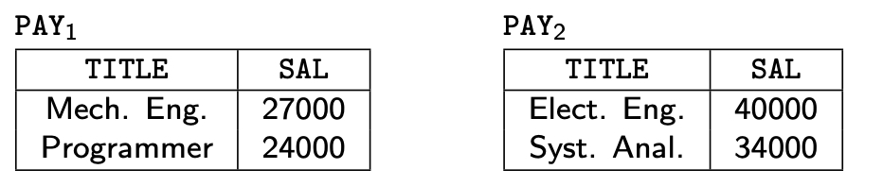
PHF – Example

Slide 52
PHF – Example
Fragmentation of relation PROJ
Applications:
Find the name and budget of projects given their LOC.
Issued at three sites
Access project information according to budget
one site accesses ≤200000 other accesses >200000
Simple predicates
For application (1)
p₁ : LOC = “Montreal”
p₂ : LOC = “New York”
p₃ : LOC = “Paris”
For application (2)
p₄ : BUDGET ≤ 200000
p₅ : BUDGET > 200000
Pr = Pr' = {p₁, p₂, p₃, p₄, p₅}

Slide 53
PHF – Example
Fragmentation of relation PROJ continued
Minterm fragments left after elimination
m₁ : (LOC = “Montreal”) ∧ (BUDGET ≤ 200000)
m₂ : (LOC = “Montreal”) ∧ (BUDGET > 200000)
m₃ : (LOC = “New York”) ∧ (BUDGET ≤ 200000)
m₄ : (LOC = “New York”) ∧ (BUDGET > 200000)
m₅ : (LOC = “Paris”) ∧ (BUDGET ≤ 200000)
m₆ : (LOC = “Paris”) ∧ (BUDGET > 200000)

Slide 54
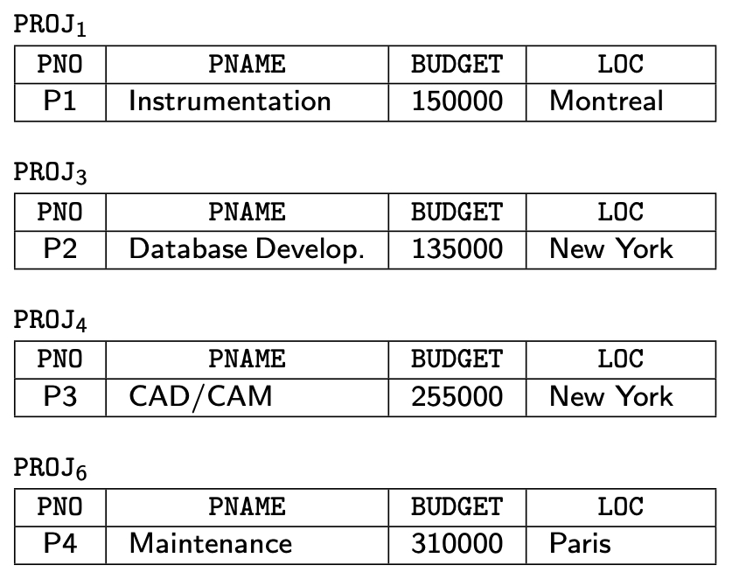
PHF – Example

Slide 55
PHF – Correctness
Completeness
Since Pr' is complete and minimal, the selection predicates are complete
Reconstruction
If relation R is fragmented into F_{R} = {R₁,R₂,…,R_{r}}
R = ∪_{∀Ri ∈FR} R_{i}
Disjointness
Minterm predicates that form the basis of fragmentation should be mutually exclusive.

Slide 56
Derived Horizontal Fragmentation
Defined on a target (member) relation of a link according to a selection operation specified on its source (owner).
Each link is an equijoin.
Equijoin can be implemented by means of semijoins.

Slide 57
DHF – Definition
Given a link L where owner(L)=S and member(L)=R, the derived horizontal fragments of R are defined as
R_{i} = R ⋉_{F} S_{i}, 1≤i≤w
where w is the maximum number of fragments that will be defined on R and
S_{i} = σ_{Fi} (S)
where F_{i} is the formula according to which the primary horizontal fragment S_{i} is defined.

Slide 58
Semijoin Example

Slide 59
DHF – Example
Given link L₁ where owner(L₁)=PAY and member(L₁)=EMP
EMP₁ = EMP ⋉ PAY₁
EMP₂ = EMP ⋉ PAY₂
where
PAY₁ = σ_{SAL≤30000}(PAY)
PAY₂ = σ_{SAL>30000}(PAY)
PAY₁
PAY₂
TITLE
SAL
TITLE
SAL
Mech. Eng.
27000
Elect. Eng.
40000
Programmer
24000
Syst. Anal.
34000
EMP₂
EMP₁
ENO
ENAME
TITLE
ENO
ENAME
TITLE
E1
J. Doe
Elect. Eng.
E2
M. Smith
Syst. Anal.
E3
A. Lee
Mech. Eng.
E5
B. Casey
Syst. Anal.
E4
J. Miller
Programmer
E6
L. Chu
Elect. Eng.
E7
R. Davis
Mech. Eng.
E8
J. Jones
Syst. Anal.

Slide 60

Benefits of Derived Fragmentation
PAY (TITLE, SAL)
Primary Fragmentation:
PAY1 = σ SAL ≤ 30 , 000 (PAY )
PAY2 = σ SAL > 30 , 000 (PAY )
EMP (ENO, ENAME, TITLE)
EMP1 = EMP ⋉ PAY1
EMP2 = EMP ⋉ PAY2
Using Derived Fragmentation:
EMP1 EMP2
PAY1 PAY2
EMP_{i} and PAY_{i} can be allocated to the same site.
Not using derived fragmentation: one can divide EMP into EMP1 and EMP2 based on TITLE and divide PAY into PAY1, PAY2, PAY3 based on SAL.
To join EMP and PAY, we have the following scenarios:
PAY1PAY2 PAY3
EMP1 EMP2
More communication overhead !

Slide 61
3 Inputs for DHF
A set of partitions of source (owner) relation (PAY1, PAY2)
Target (member) relation
A set of semijion predicates between owner and member (E.TITLE + P.TITLE)

Slide 62
Correctness of Fragmentation
Completeness
Decomposition of relation R into fragments R₁, R₂, ..., R_{n} is complete if and only if each data item in R can also be found in some R_{i}
Reconstruction
If relation R is decomposed into fragments R₁, R₂, ..., R_{n}, then there should exist some relational operator ∇ such that
R = ∇_{1≤i≤n}R_{i}
Disjointness
If relation R is decomposed into fragments R₁, R₂, ..., R_{n}, and data item d_{i} is in R_{j}, then d_{i} should not be in any other fragment R_{k} (k ≠ j ).

Slide 63
PHF – Correctness
Completeness
Since Pr' is complete and minimal, the selection predicates are complete
Reconstruction
If relation R is fragmented into F_{R} = {R₁,R₂,…,R_{r}}
R = ∪_{∀Ri ∈FR} R_{i}
Disjointness
Minterm predicates that form the basis of fragmentation should be mutually exclusive.

Slide 64
DHF – Correctness
Completeness
Referential integrity
Let R be the target (member) relation of a link whose source (owner) is relation S which is fragmented as F_{S} = {S₁, S₂, ..., S_{n}}. Furthermore, let A be the join attribute between R and S. Then, for each tuple t of R, there should be a tuple t' of S such that
t[A] = t' [A]
Reconstruction
Same as primary horizontal fragmentation.
Disjointness
Simple join graphs between the owner and the member fragments.

Slide 65
Join Graph
Join Graph
PAY
TITLE,
SAL
L₁
EMP
PROJ
ENO, ENAME, TITLE
PNO, PNAME, BUDGET, LOC
L₂
L₃
ASG
ENO, PNO,
RESP, DUR

Slide 66
Partitioned and Simple Join Graphs
Partitioned Join Graph
Simple Join Graph :There is only one link coming in or going out of a fragment.
PAY₁
PAY
TITLE,
SAL
TITLE,
SAL
EMP₁
EMP₁
EMP₂
ENO, ENAME, TITLE
ENO, ENAME, TITLE
ENO, ENAME, TITLE
PAY₂
TITLE,
SAL
EMP₂
ENO, ENAME, TITLE

Slide 67
DHF – Disjointness
Disjointness can be guaranteed if the join graph is simple.
Otherwise, it is necessary to investigate actual tuple values. In general, we do not want a tuple of a member relation to join with two or more tuples of the owner relation when these tuples are in different fragments of the owner.
The minterm predicates in the owner fragmentation are mutually exclusive, so the fragmentation of PAY is disjoint.
For relation EMP, however, we require that
1. Each engineer has a single title.
2. Each title have a single salary value associated with it.
Since these two rules follow from the semantics of the database, the fragmentation of EMP with respect to PAY is also disjoint.
Primary Fragmentation:
PAY1 = σ SAL ≤ 30 , 000 (PAY )
PAY2 = σ SAL > 30 , 000 (PAY )

